Slide 1



T20_Power_BI_Final
View in Power BI
Last data refresh:
6/18/2024 9:16:37 PM UTC
Downloaded at:
6/19/2024 4:06:33 PM UTC

Slide 2
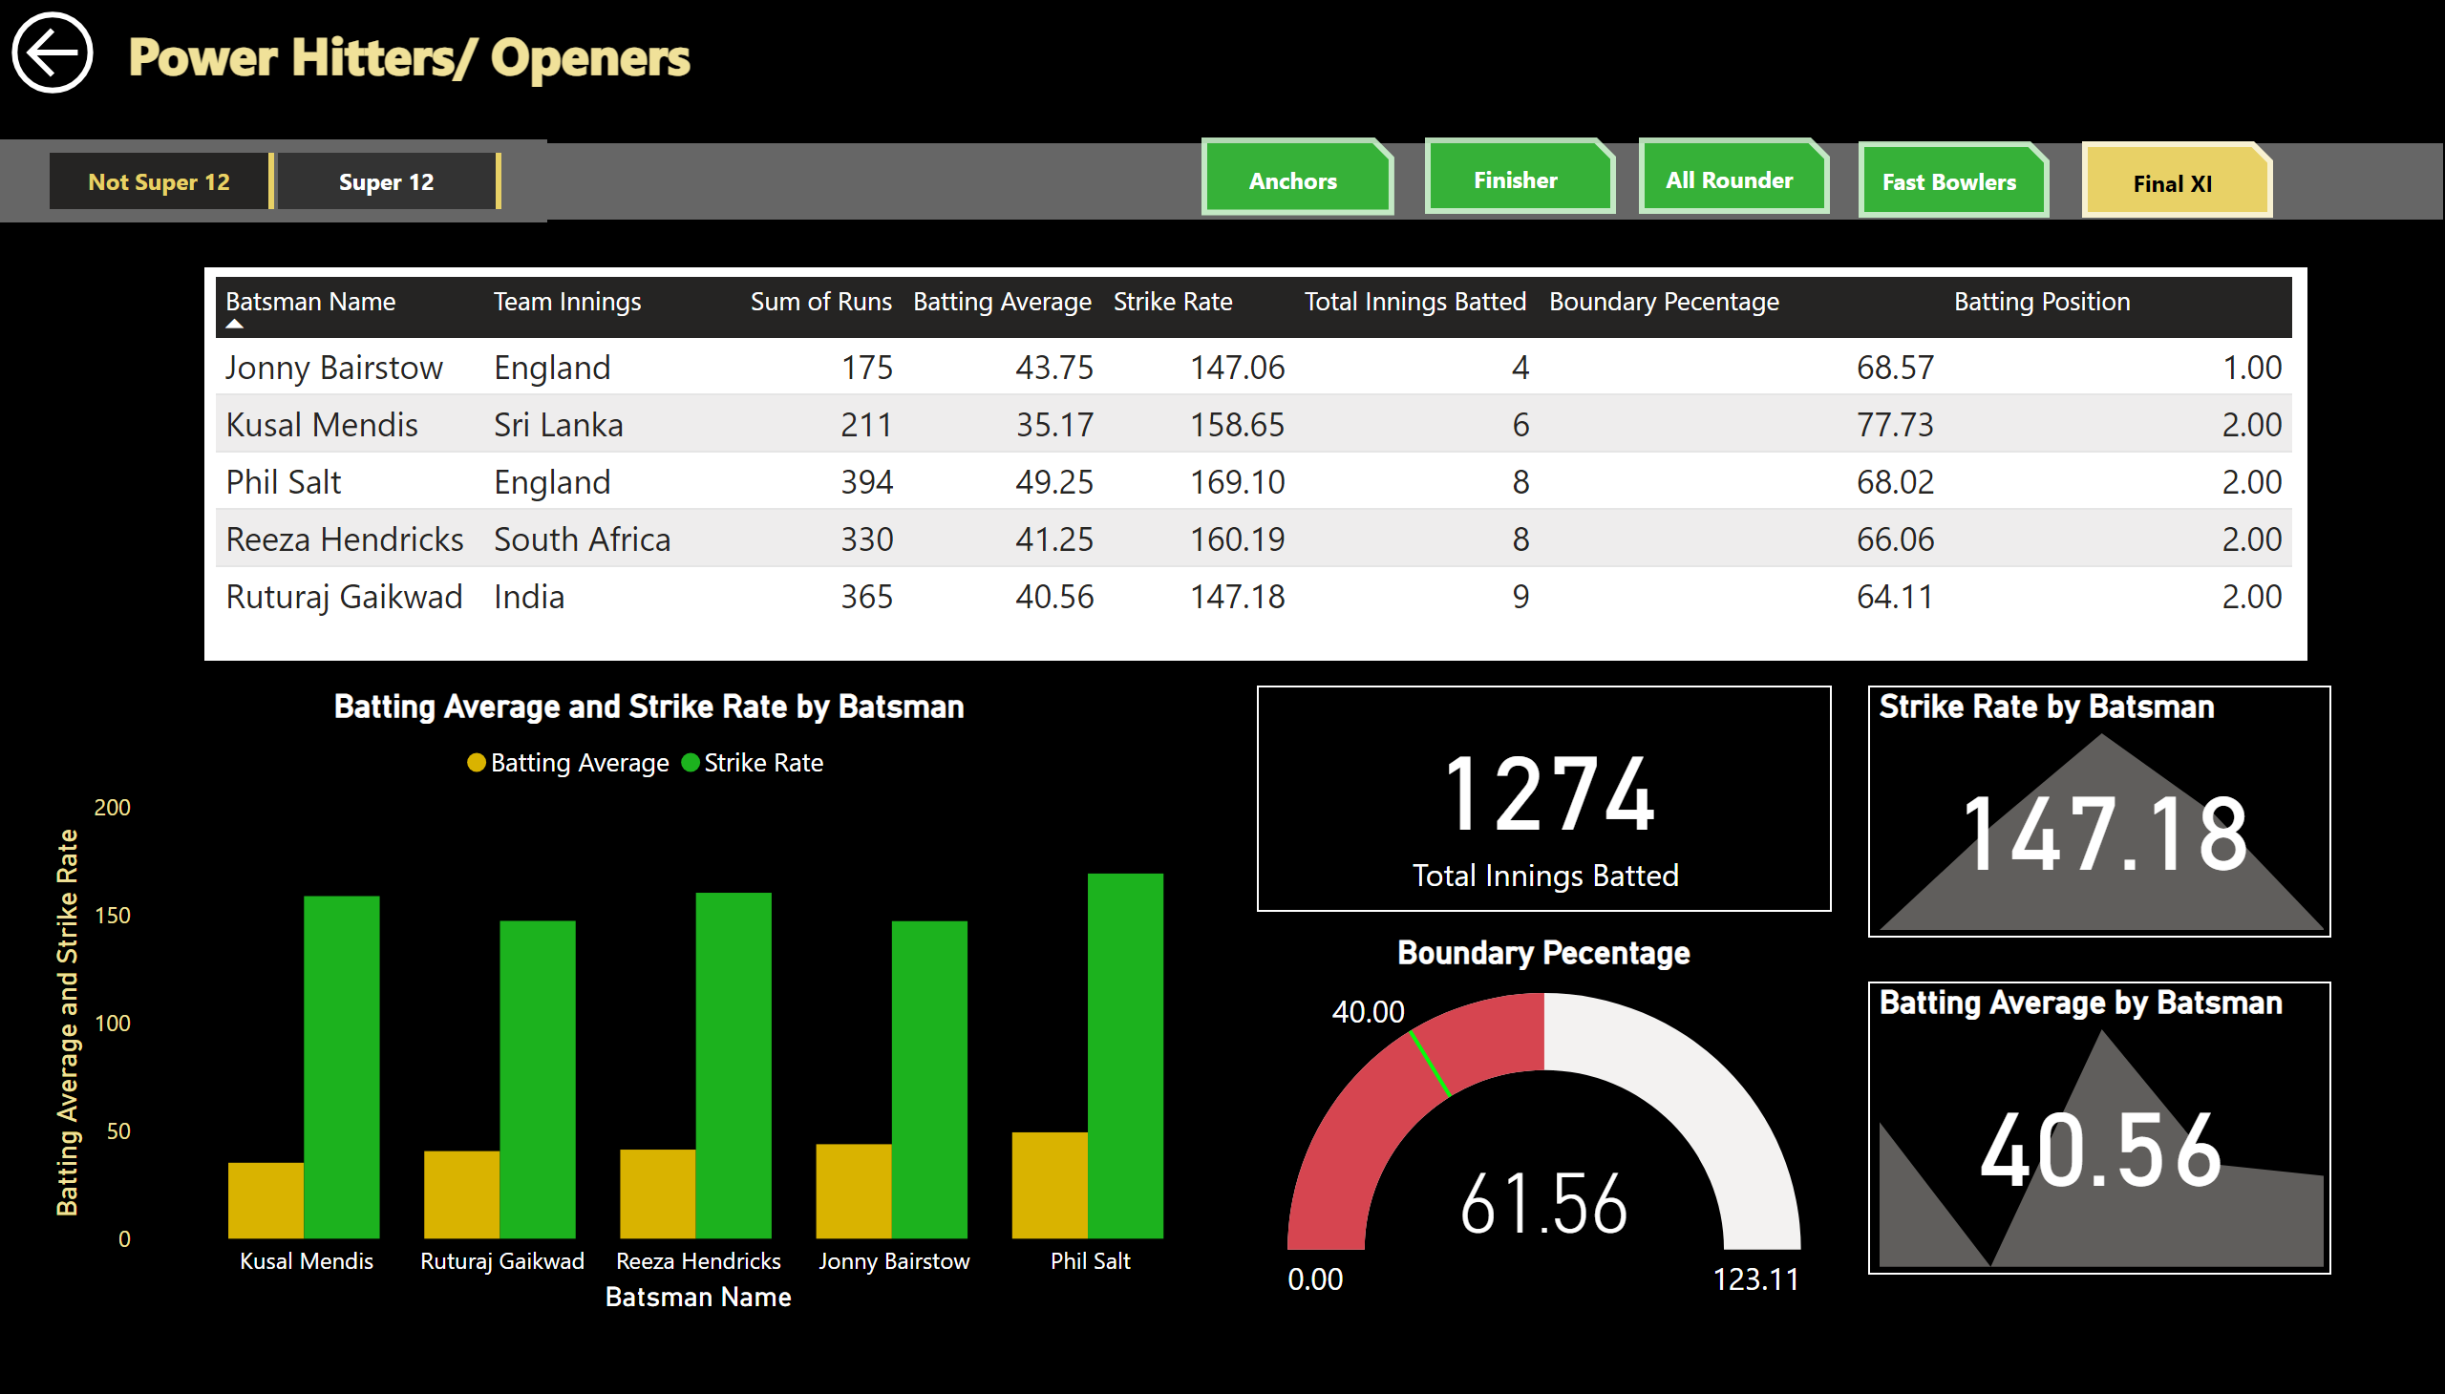
Power Hitters/ Openers
Notes:
tableEx
No alt text provided
Batting Average and Strike Rate by Batsman
No alt text provided
gauge
No alt text provided
textbox
No alt text provided
actionButton
No alt text provided
slicer
No alt text provided
shape
No alt text provided
actionButton
No alt text provided
actionButton
No alt text provided
actionButton
No alt text provided
actionButton
No alt text provided
actionButton
No alt text provided
card
No alt text provided
Strike Rate by Batsman
No alt text provided
Batting Average by Batsman
No alt text provided

Slide 3
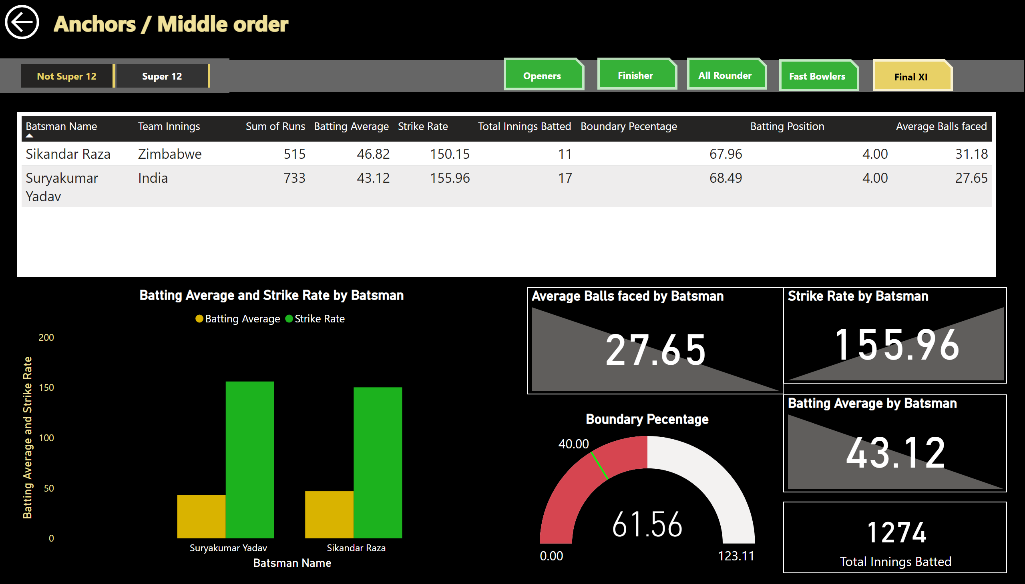
Anchors / Middle Order
Notes:
Batting Average and Strike Rate by Batsman
No alt text provided
gauge
No alt text provided
textbox
No alt text provided
actionButton
No alt text provided
shape
No alt text provided
actionButton
No alt text provided
actionButton
No alt text provided
actionButton
No alt text provided
actionButton
No alt text provided
actionButton
No alt text provided
card
No alt text provided
Strike Rate by Batsman
No alt text provided
Batting Average by Batsman
No alt text provided
Average Balls faced by Batsman
No alt text provided
slicer
No alt text provided
tableEx
No alt text provided

Slide 4
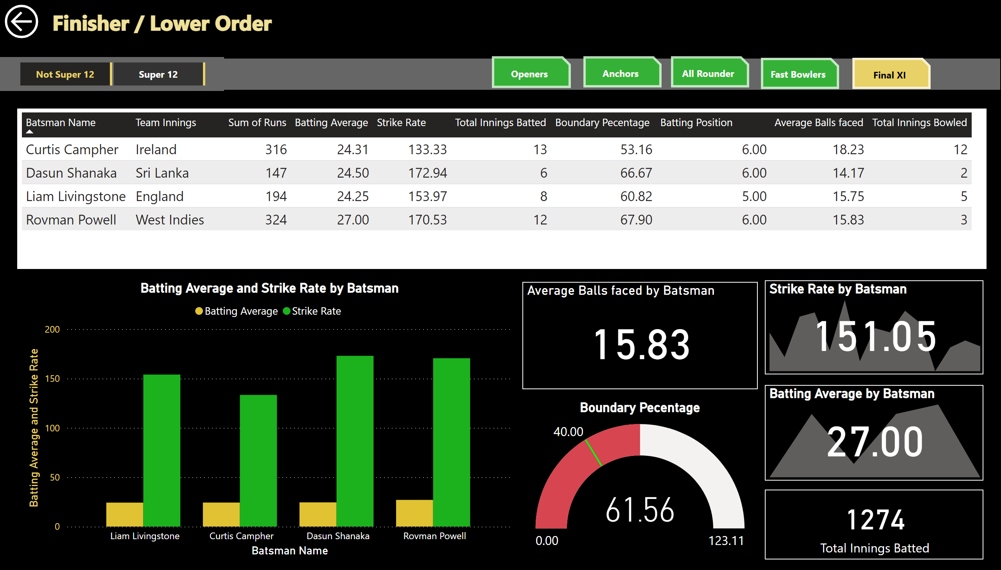
Finisher / Lower Order Anchor
Notes:
gauge
No alt text provided
textbox
No alt text provided
actionButton
No alt text provided
shape
No alt text provided
actionButton
No alt text provided
actionButton
No alt text provided
actionButton
No alt text provided
actionButton
No alt text provided
actionButton
No alt text provided
card
No alt text provided
Strike Rate by Batsman
No alt text provided
Batting Average by Batsman
No alt text provided
slicer
No alt text provided
tableEx
No alt text provided
Batting Average and Strike Rate by Batsman
No alt text provided
Average Balls faced by Batsman
No alt text provided

Slide 5
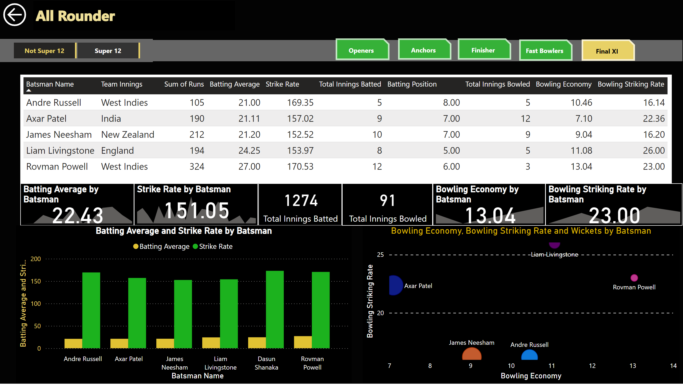
All Rounder
Notes:
textbox
No alt text provided
actionButton
No alt text provided
shape
No alt text provided
actionButton
No alt text provided
actionButton
No alt text provided
actionButton
No alt text provided
actionButton
No alt text provided
actionButton
No alt text provided
card
No alt text provided
Strike Rate by Batsman
No alt text provided
Batting Average by Batsman
No alt text provided
slicer
No alt text provided
tableEx
No alt text provided
Batting Average and Strike Rate by Batsman
No alt text provided
Bowling Economy, Bowling Striking Rate and Wickets by Batsman
No alt text provided
Bowling Economy by Batsman
No alt text provided
Bowling Striking Rate by Batsman
No alt text provided
card
No alt text provided

Slide 6
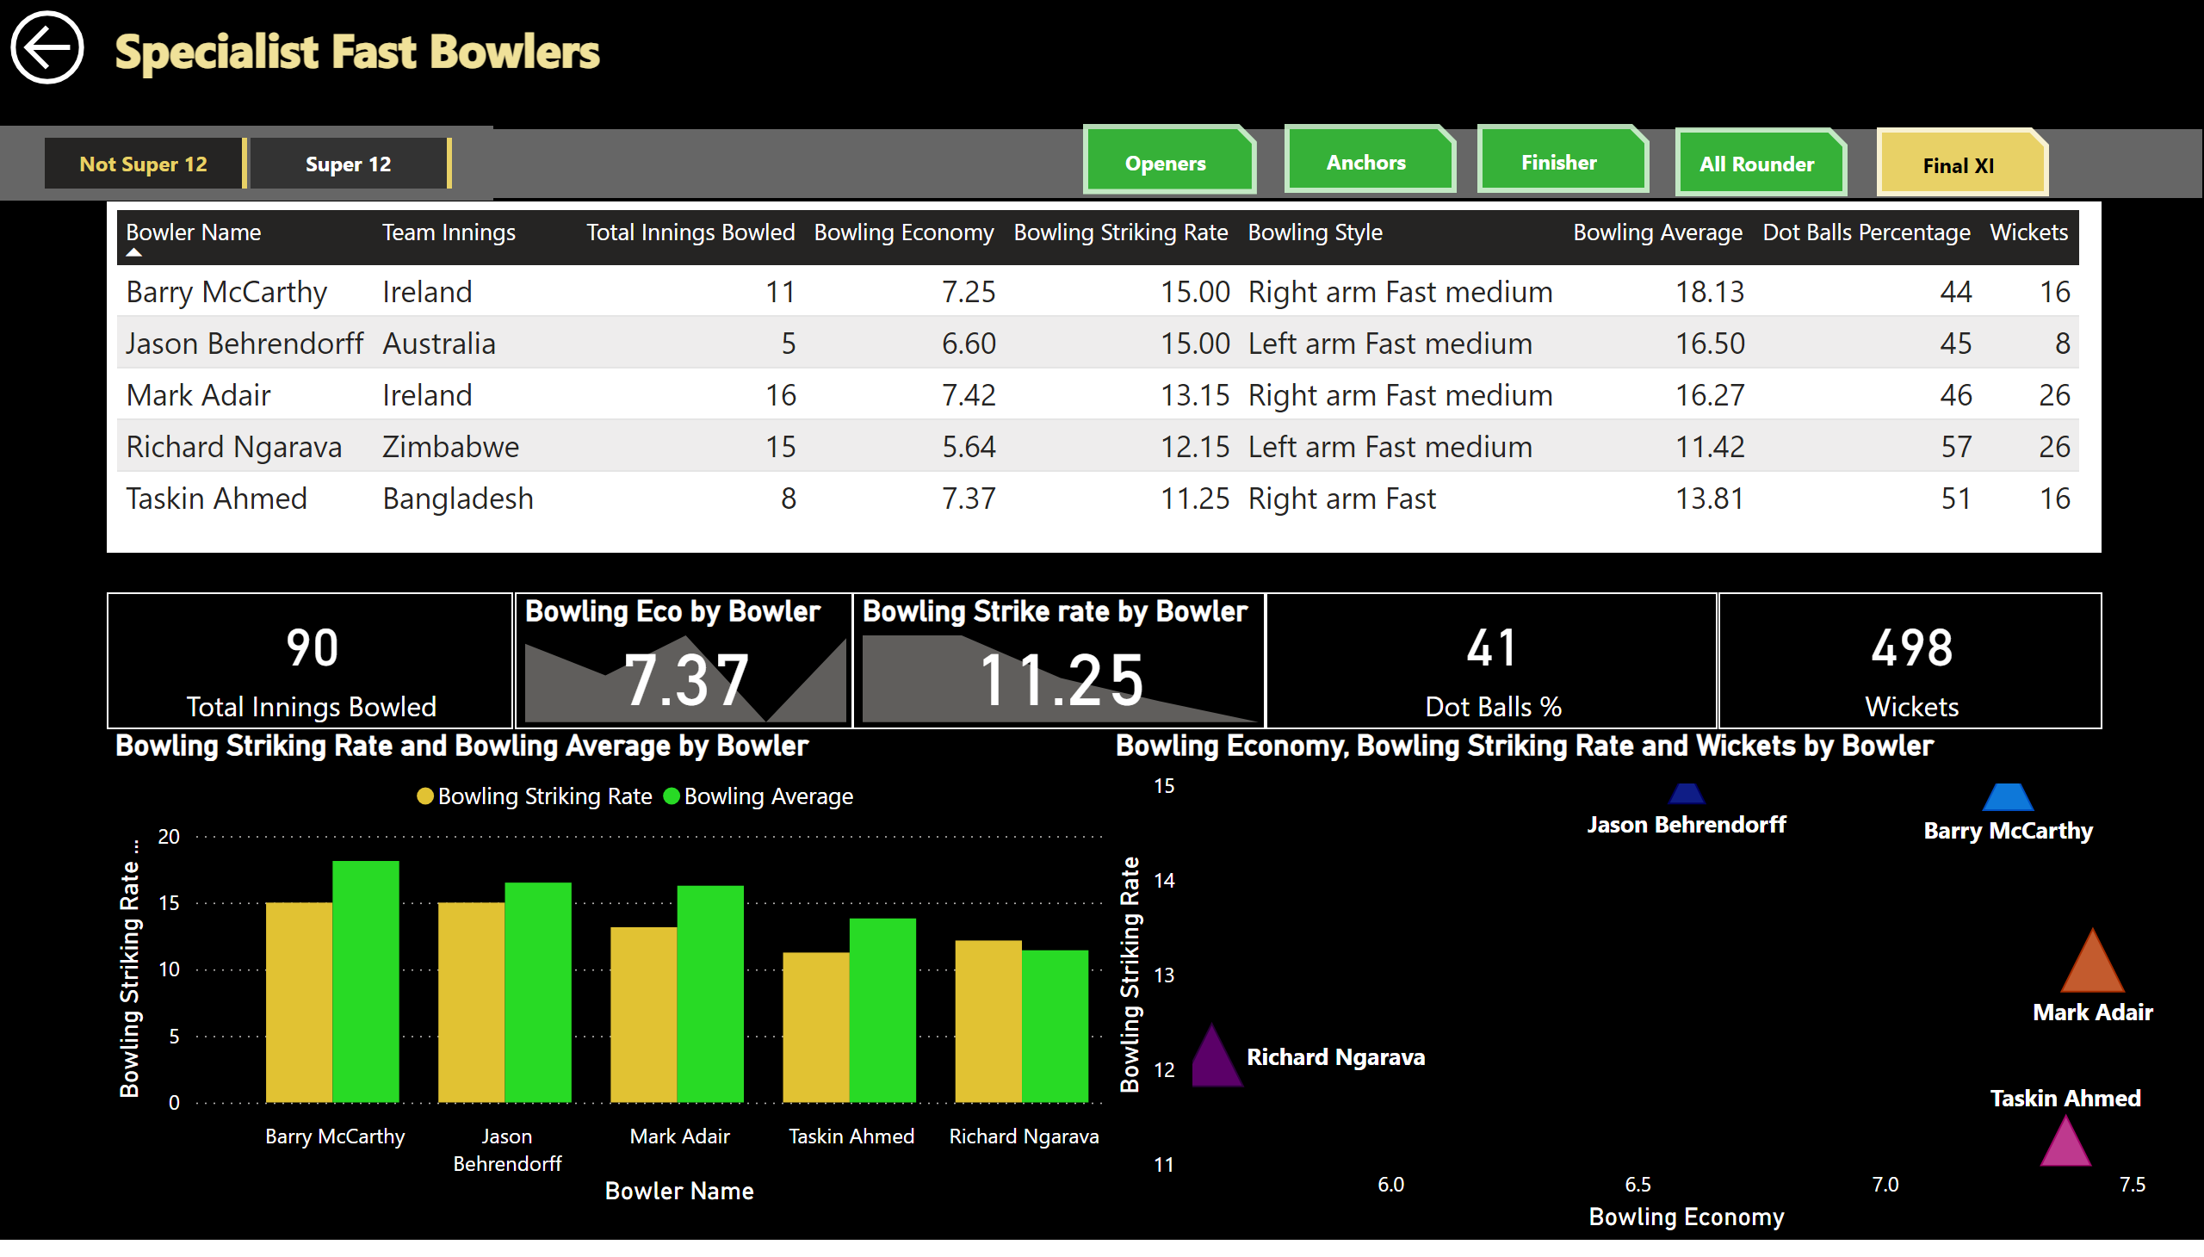
Specialist Fast Bowlers
Notes:
textbox
No alt text provided
actionButton
No alt text provided
shape
No alt text provided
actionButton
No alt text provided
actionButton
No alt text provided
actionButton
No alt text provided
actionButton
No alt text provided
actionButton
No alt text provided
slicer
No alt text provided
tableEx
No alt text provided
Bowling Striking Rate and Bowling Average by Bowler
No alt text provided
Bowling Economy, Bowling Striking Rate and Wickets by Bowler
No alt text provided
card
No alt text provided
Bowling Eco by Bowler
No alt text provided
Bowling Strike rate by Bowler
No alt text provided
card
No alt text provided
card
No alt text provided

Slide 7
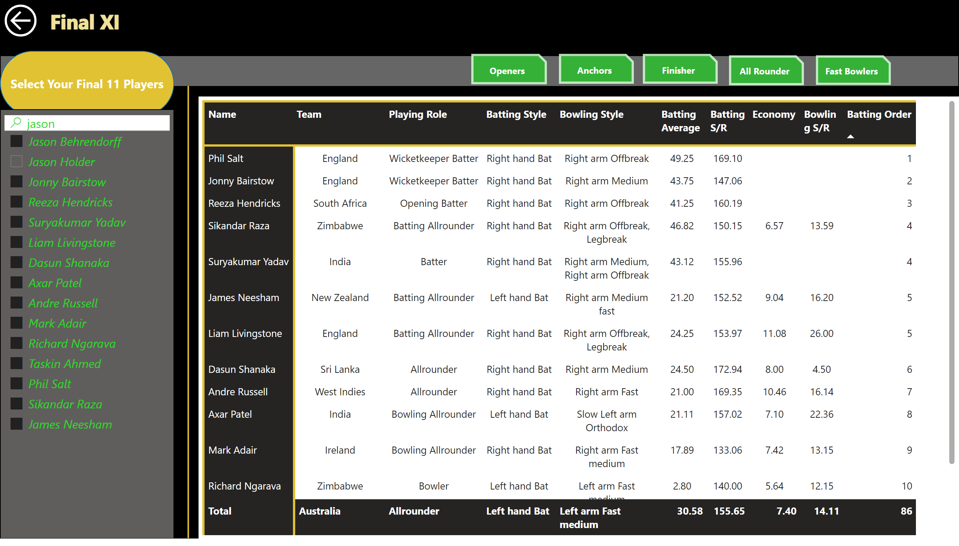
Final 11
Notes:
shape
No alt text provided
textbox
No alt text provided
actionButton
No alt text provided
actionButton
No alt text provided
actionButton
No alt text provided
actionButton
No alt text provided
actionButton
No alt text provided
actionButton
No alt text provided
slicer
No alt text provided
shape
No alt text provided
shape
No alt text provided
pivotTable
No alt text provided

